Slide 1
Kitky - Pick-up & Drop System
Team Name - DB Devs (Group 3)
Team Members:
Stafny Velitia Karkada
Srijith D Makam
Jay Vipul Gala
Kunal Bhoyar

Slide 2
Problem Statement
It often happens that you step out and forget something or say you want to deliver something to a friend, or you want to pick up something from someone. This becomes difficult because of lack of time and vehicle unavailability.
We also plan on addressing the issue we face with Facebook marketplace or similar platforms where you find things in the marketplace but cannot get them delivered.
In the current market, we have apps like DoorDash, Postmates and Instacart that delivers things from a store, but we don’t yet have an system that just lets you pick up things from one place to another.

Slide 3
Objectives
To create a Pick-up and Drop system that lets anyone deliver things to any desired location nearby.
To create a fast-paced pick-up and drop service.
To develop a innovative and customer-centric delivery system.
To transform the way items are picked and delivered.
To implement a system where anybody with a car/bike can sign up to be a delivery agent.
To study Database Management Systems through this project.

Slide 4
Solution
Developing a service that can pick up anything you need and deliver it to any nearby place instantly.
This also solves the problem we face with Facebook Marketplace; it so happens that you find something you need but there’s no way to get it because you don’t have a vehicle. So, using our service you can easily get it delivered right to your doorstep.
The system will allow anyone with a vehicle, be it a car or bike, to enlist as an agent. This inclusivity ensures a dynamic pool of delivery personnel, contributing to the efficiency and speed of the service.
The scope of this project extends to the creation of a robust database management system that facilitates smooth coordination between senders and receivers, enhanced convenience for individuals looking to dispatch a variety of items, increased earning opportunities for drivers, efficient and reliable delivery service catering to a broader market.

Slide 5
Entity-Relationship Diagram
https://drive.google.com/file/d/1GvFnM7nBuNF6cGHJ0d0mbSphL8LYi7Bs/view?usp=sharing

Slide 6
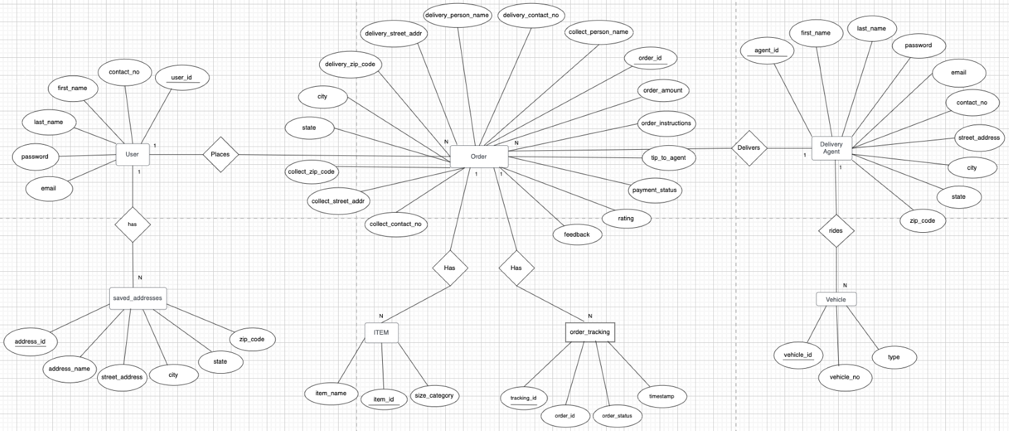

Slide 7
Logical Diagram

Slide 8
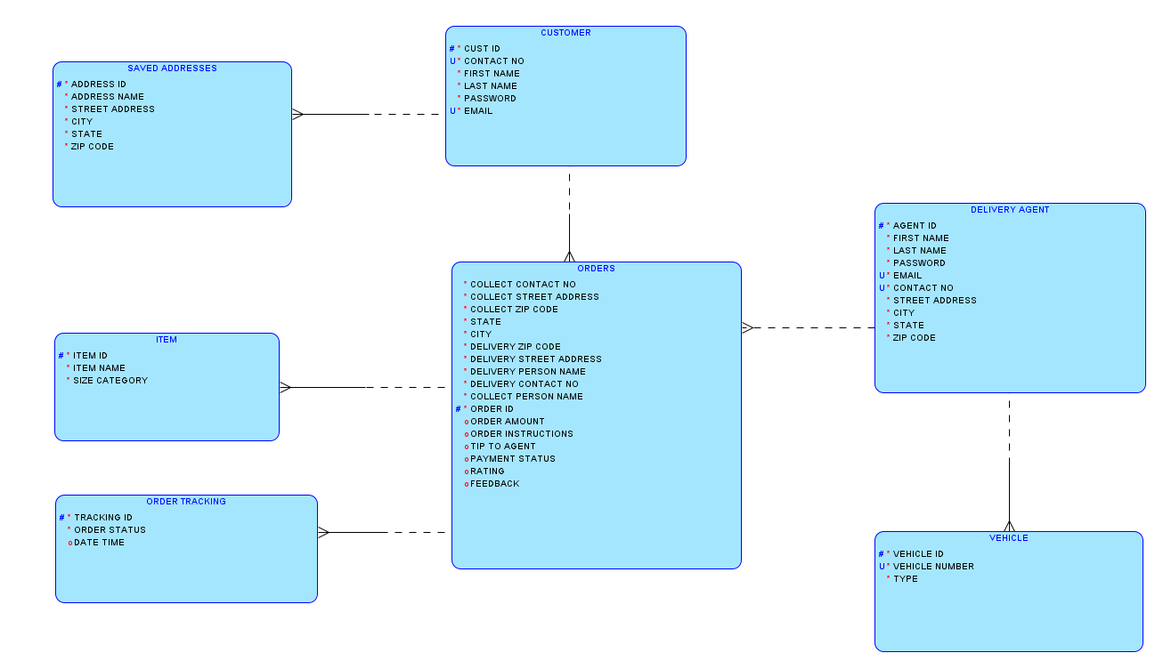

Slide 9
Relational Diagram

Slide 10
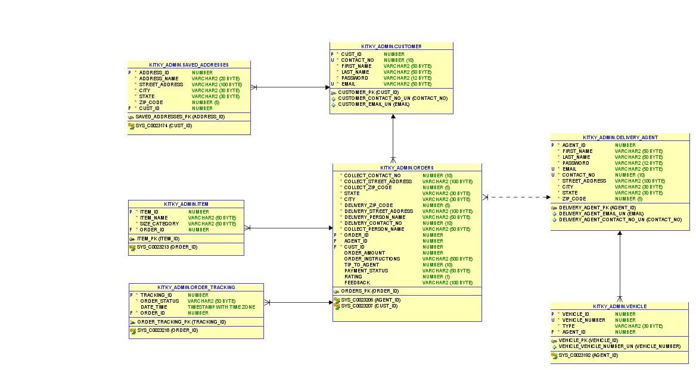

Slide 11
DATA FLOW DIAGRAM
CUSTOMER ONBOARDING FLOW
https://drive.google.com/file/d/1pKLvmOtjGwn_QlCFdGHHV3cNiUYDcGtV/view?usp=sharing

Slide 12
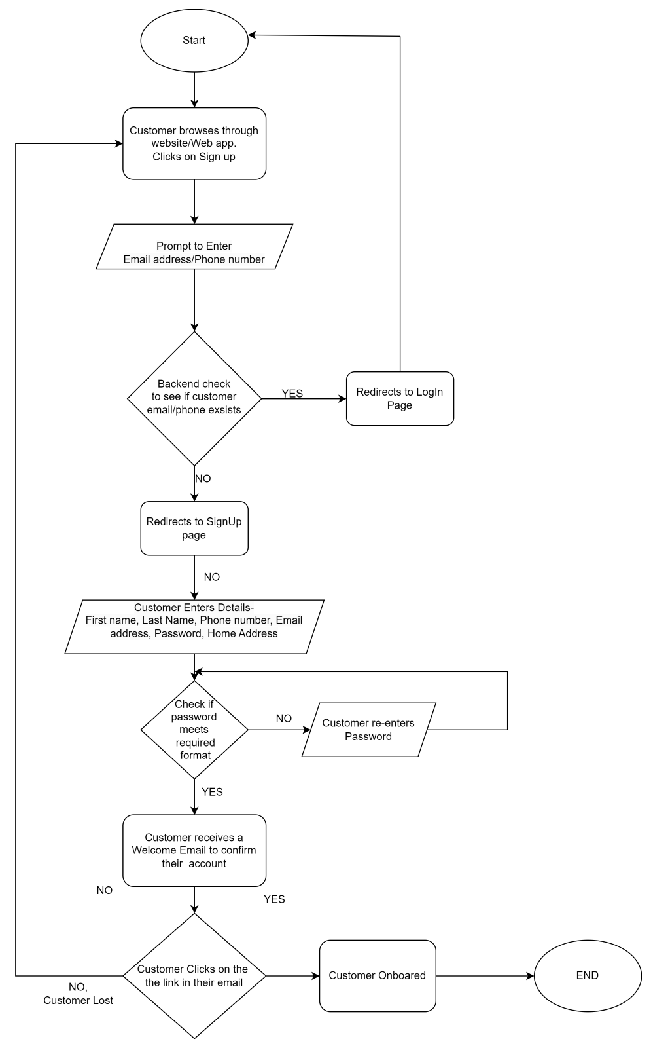

Slide 13
DATA FLOW DIAGRAM
ORDER MANAGEMENT FLOW
https://drive.google.com/file/d/1f4h6m6MqkMGPIzd2jGtMIc44OJVq37gX/view?usp=sharing

Slide 14
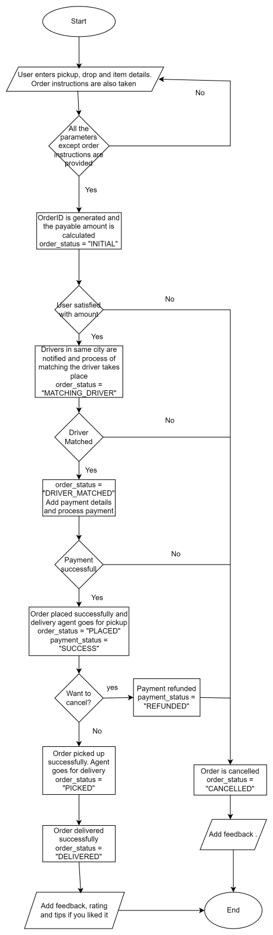

Slide 15
DATA FLOW DIAGRAM
DELIVERY AGENT ONBOARDING DFD
https://drive.google.com/file/d/1YShRGBj6Fk2Jt0hkIT_ENQh1tSU-J9zE/view?usp=sharing

Slide 16
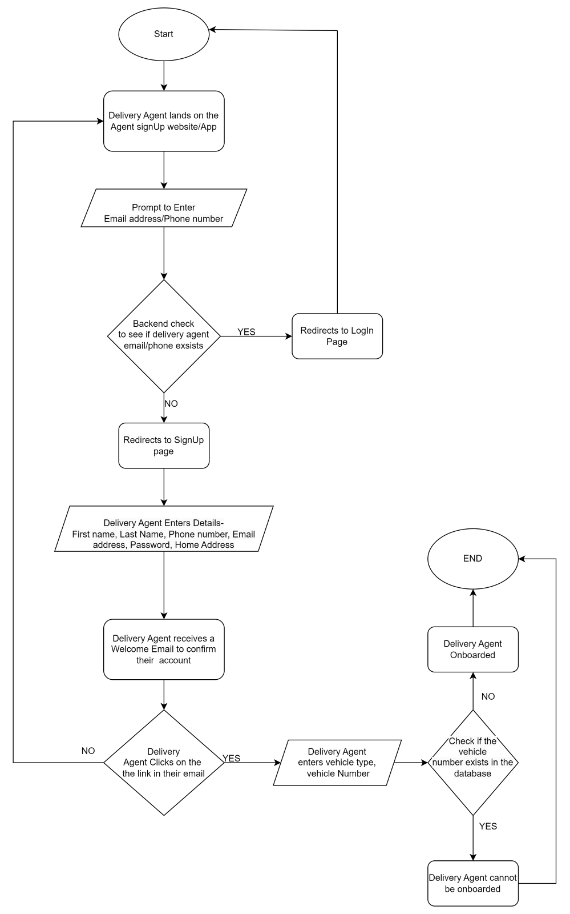

Slide 17
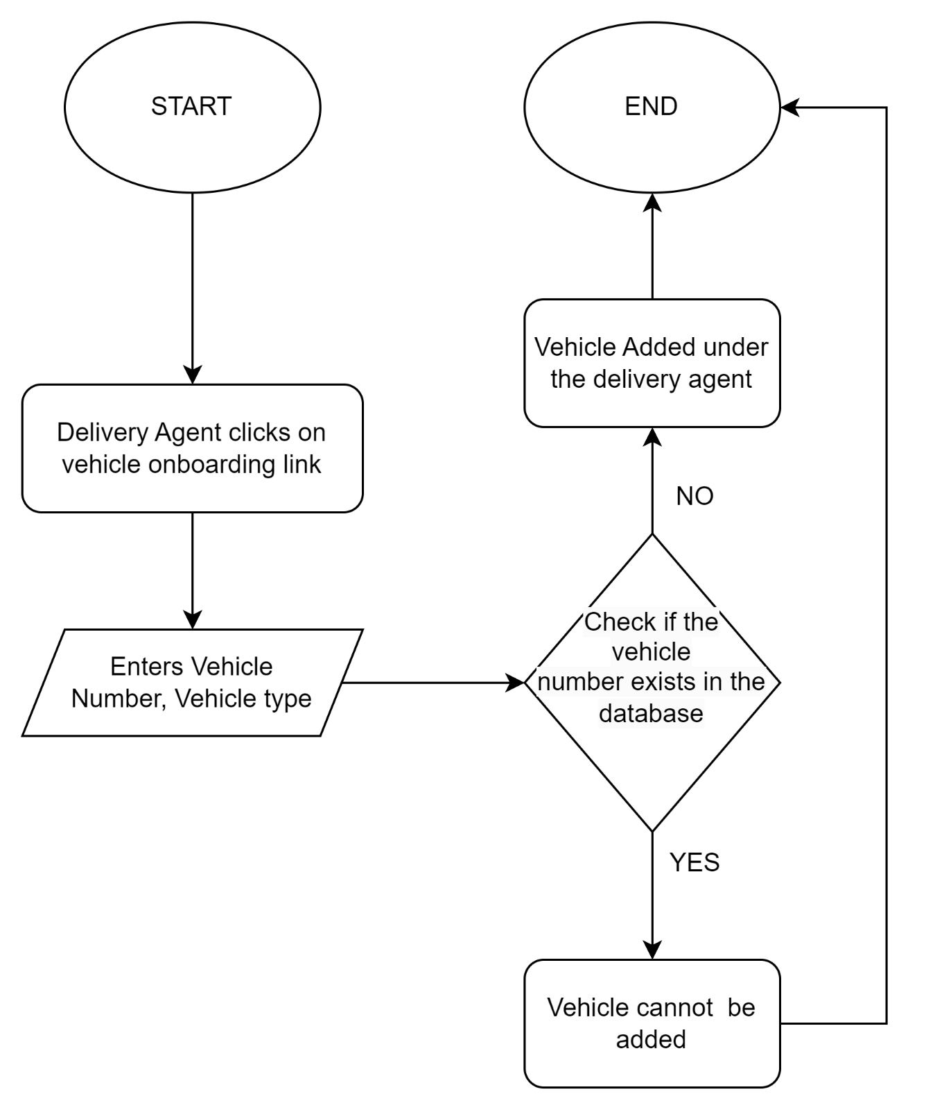
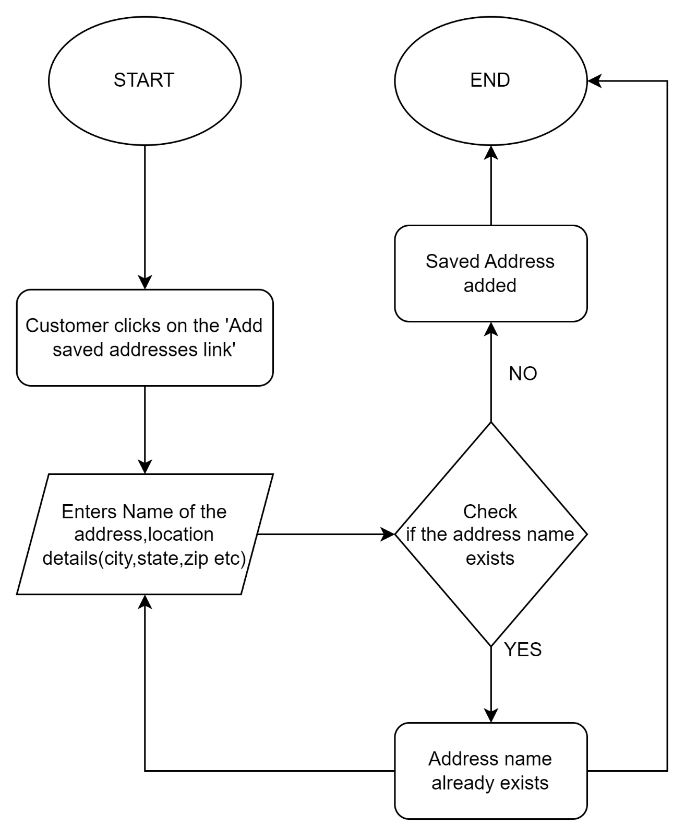
Vehicle Onboarding
Adding Saved Addresses

Slide 18
Views and Reports
Report that shows the Total salary earned by the Driver
-(This is derived by calculating the sum of the tips received and 30% of each order amount)
Report to see the Total Number of Cancelled Orders and the Feedback on that order
Report to view the Total Orders Placed Per Day
Report that shows the Total number of Drivers and the total Number of Customers currently
Report to Display Driver Feedback Summary for all orders
Agent Vehicle Assignments report-
-(This view specifically focuses on the vehicle assignments for delivery agents, providing a clear mapping between agents and their assigned vehicles)

Slide 19
User Roles
KITKY_ADMIN
ORDER
MANAGER
BUSINESS ANALYST
DELIVERY AGENT
MANAGER
USER MANAGER

Slide 20
User Roles
KITKY_ADMIN
ORDER
MANAGER
Creates all the Tables
Creates all the other User and assigns the required permissions
Creates the different views(the table views and the Report views)
Inserts records to the Orders tables, Items table, Order_Tracking Table
All the Order related aspects are looked after by the Order manager

Slide 21
User Roles-Contd
DELIVERY AGENT
MANAGER
USER MANAGER
BUSINESS ANALYST
Inserts records to the Delivery Agent and the Vehicle Tables
Looks after all of the aspects related to the Delivery agent and the vehicles owned by the delivery agent
Inserts records to the User tables, the Saved Addresses table
Looks after all of the aspects related to the User
This User has only access to view the different Reports created by the Kitky_admin

Slide 22
SECURITY & PERMISSIONS
The Kitky Database Management System ensures distinct permission and access for each of the User roles created.
Only the Kitky Admin has the all the rights.
User_Manager: User Manager will have CRUD rights for User and Saved_addresses tables and read access of Order table.
Order_Manager: Order_Manager will have CRUD rights for Order, Item and Order_tracking tables and read access of User and Delivery_agent tables.
Delivery_Agent_Manager: Delivery_Agent_Manager will have CRUD rights for Delivery_agent and Vehicle tables and read access of Order table
Business_Analyst: He will have read access to Business Report views.

Slide 23
Contribution to Phase 4
Srijith Makam:Stored Procedures, User creation package, DMLs
Jay Gala:DDL,Trigger, Stored Procedures,Kitky_admin creation script
Kunal Bhoyar:Stored Procedures,Function,View script
Stafny Velitia:Stored Procedures,Business reports,Documentation
Collaborated Effort:
Business problem & solution
ER Diagram
Business rules/constraints
Data Flow Diagrams
Logical Diagrams,
Relational Diagrams

Slide 24
DEMO TIME…

Slide 25
Thank You !

